Slide 1
Ch0 About the Course
Bilingual teaching
What ?
Why?
  Frontier knowledge and technologies…
  Classical text books
  Master, or Doctor degree
  Much more……

Slide 2
Ch0 About the Course
Basic information
WWH----Why, What, How
Preliminary knowledge
Textbooks and references
Grading
About myself
My encouragement

Slide 3
Basic information
学位课---考试 (英语描述， 中或英文答题）
32学时
2学分
……

Slide 4
Why
Software is indispensable in many domains¹
Software crisis: over budget and schedule
SE: Develop high quality software² to attack or at least relief software crisis
  develop software within budget and schedule
  Programmer------analyst: distinct difference from others…
  No SE is equally Flash marriage
Notes:
1 编写程序是现代工程师的基本技能。软件，替代人的工作
2 好用（好卖），即需求正确；成本低，即高质量的设计

Slide 5
What
software and program
  Software >>program
    business modeling
    requirement modeling
    analysis modeling
    design modeling and implementation

Slide 6
What ---divide and conquer, partition, deco…
现代软件工程 (Modern Software Engineering)
  Engineering: is the discipline and profession of applying technical and scientific knowledge and utilizing natural laws and physical resources in order to design and implement materials, structures, machines, devices, systems, and processes that safely realize a desired objective and meet specified criteria.
  Software= data + program + document
  Software Engineering：Developing Software
  Modern: Recent popular technology

Slide 7
How
Like 马列 course:
My Lecture
  Bilingual lecture: at least you can learn some English.
  Classical textbook
  2/8 law. It states that, for many events, roughly 80% of the effects come from 20% of the causes
    It is a universal rule that governs our lives behind the scenes, it resides silently, only observed by those enlightened of its existence. The ones who do recognize its power, spend more of their precious time pursuing their passions, making more money, and living happier lives.
    examples
Reinterpret it by exploiting 大白话(plain and intuitive) ¹
Notes:
1 Einstein: If you can not explain it to a six year old, you do not understand it yourself.

Slide 8
How (continued)
Study
Focus on understanding, thinking
Much more efforts(practices) needed than attending classes…
For me I have read several classical books.
Sensitive to it, be passionate

Slide 9
Preliminary knowledge
Basic SE
UML (Unified Modeling Language)
OO related, such as OO language (C++, Java), OO paradigm.
3S = DS + DBMS + OS
…
The above is preferred, not required.

Slide 10
Textbooks and references
Textbooks
  Software engineering, Ian Sommerville
  Software engineering: a practitioner’s approach, Roger S.Pressman
References

Slide 11
References-1
《软件方法》潘加宇 清华大学出版社
  www.umlchina.com

Slide 12
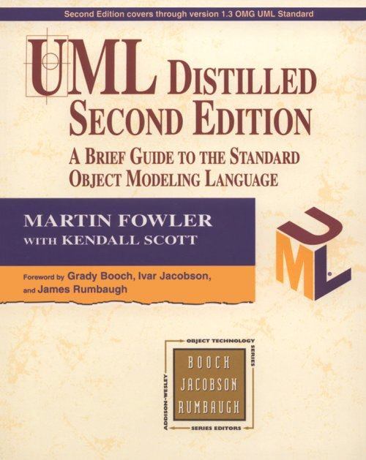
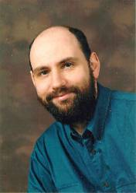
References-2
UML Distilled
  Martin Flower
  UML最佳入门书籍

Slide 13
References-3
Applying UML and Patterns - An Introduction to Object-Oriented Analysis and Design
  UML和模式应用-面向对象分析与设计导论
  THE BEST Object Orientated Analysis and Design tutorial book (Amazon.com)
  在 OOA/D、迭代式开发和 UML 方面是全球最畅销的书籍之一，已被翻译成多种语言并在业界和院校中被广泛使用

Slide 14
References-4
The Unified Modeling Language User Guide（UML用户指南）
The Unified Modeling Language Reference Manual（UML参考手册）
  Grady Booch
  James Rumbaugh
  Ivar Jacobson

Slide 15
References-5
Web Resources
  http://www.rational.com/uml/index.jsp
  http://www.omg.org/uml/
  http://www.sei.cmu.edu/
  http://martinfowler.com/
  http://www.umlchina.com/
  http://www.uml.org.cn/
  http://www.sawin.com.cn/
  http://www.csdn.net

Slide 16
About me
黄树成
Ph.D. from Southeast University，2007
My primary interests include machine learning，software engineering .
Email: schuang6 at 126 dot com
QQ: 191397517

Slide 17
Encouragement-1
Do the right thing, do the thing right.
寂寞让我如此美丽
No pains, no gains
Stay hungry, stay foolish
Practice to win
  http://pic.sports.sohu.com/group-680878.shtml#0
    黑曼巴养成记

Slide 18

Encouragement-2

